Slide 1
NCAA Men’s Basketball Matchup Predictions
Siwei, Ty and Zac
Notes:
Everyone introduce themselves

Slide 2

Contents
Project Introduction
Data Used
Data Preparation
Model Creation
Results
Conclusion
Questions?
Notes:
Zac

Slide 3
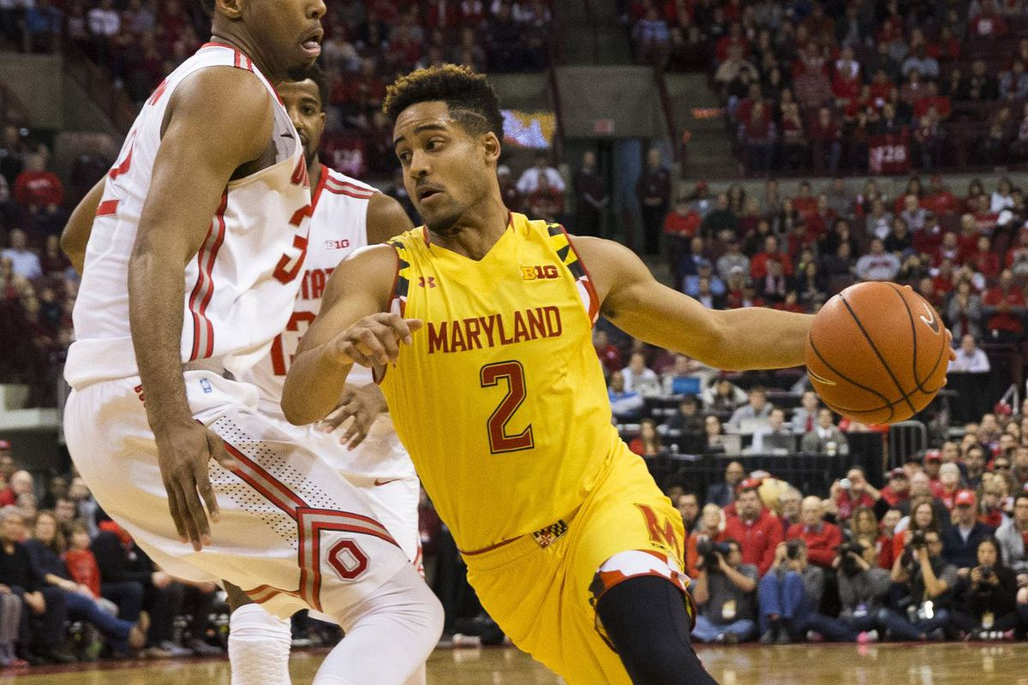
Introduction
Create a predictive analytics model for NCAA Division 1 Men's Basketball.
Predict the winner when two teams play against each other during the Division 1 regular season and also the postseason single elimination tournaments (March Madness and NIT).
Notes:
Zac

Slide 4
Data Used for our Project
Two Sets We Used:
Season Long Team Statistics for All NCAA Division 1 Schools (2016-17 and 2017-18 Seasons)
Team Matchups/Results for Regular Season and Postseason (2016-17 and 2017-18 Seasons)
Our datasets are from Sports Reference LLC at Sports-Reference.com
Sports Reference LLC brands itself as the ‘complete source for current and historical college basketball players, schools, scores and leader’ stats
Notes:
Ty

Slide 5
Some Available Statistical Categories
Strength of Schedule
Conference, Home and Away - Wins and Loses
Pace Factor
Offensive Rating
Free Throw Attempt Rate
3-Point Attempt Rate
True Shooting Percentage
Total Rebound Percentage
Assist Percentage
Steal Percentage
Block Percentage
Effective Field Goal Percentage
Turnover Percentage
Offensive Rebound Percentage
Free Throws Per Field Goal Attempt
And More...
Notes:
Ty

Slide 6
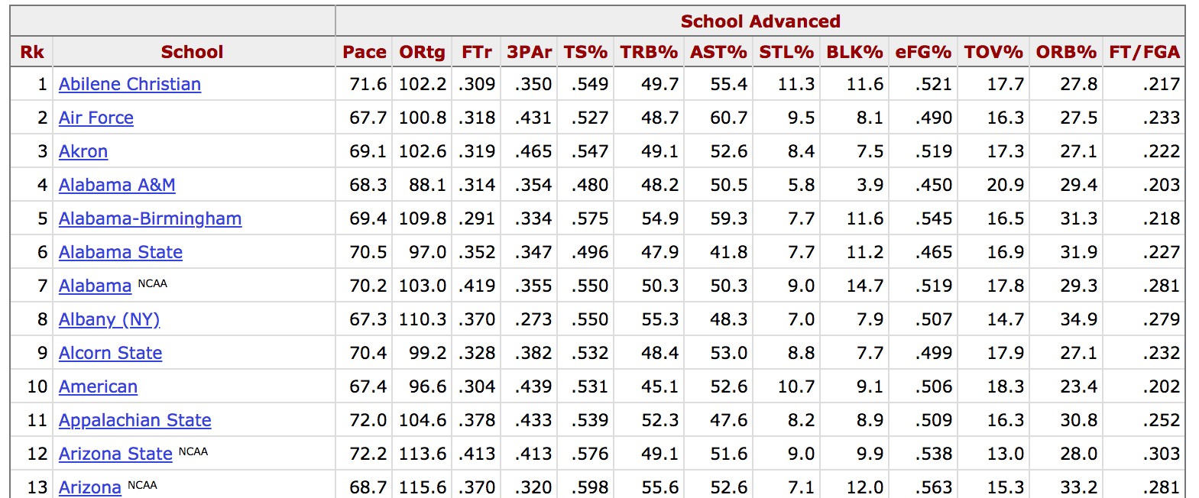
Season Long Team Stats Screenshot
Notes:
Ty

Slide 7
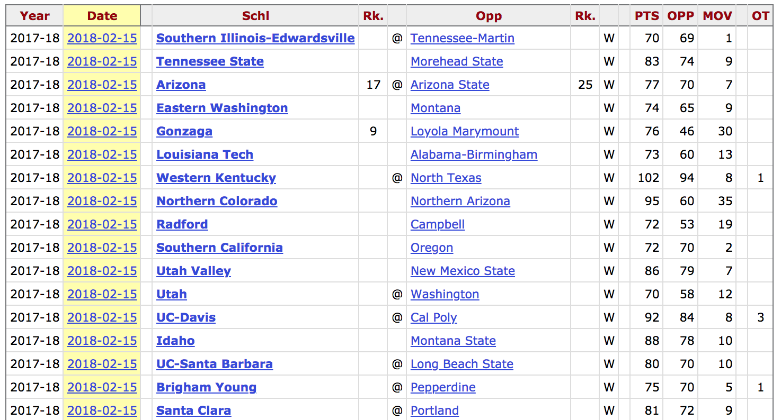
Regular Season and Postseason Matchups/Results
Notes:
Ty

Slide 8
Data Preparation
Goal: - Create a predictive model using the 2016-17 datasets (Training), in order to make predictions for the 2017-18 matchups (Testing) - Compare the teams matched up against each other (Team Matchups/Results), using the Season Long Team Statistics dataset Our Plan: - Merge the two datasets, by matching by team ID - Create features that are the results of comparing Team A and Team B’s statistical categories
Notes:
Siwei

Slide 9
Logistic Regression Predictive Model Creation
Team A/B can only win or lose (binary outcome)
Feature Creation: We chose the team statistics that we thought would be most important to a team winning an individual matchup (Ex: Shots Blocked or Steal Percentage)
We calculated the difference of each team statistic between Team A and Team B as the independent variables for our model (Ex: Team A’s Block Percentage vs. Team B’s Block Percentage)
Notes:
Siwei

Slide 10
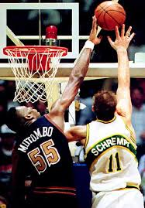
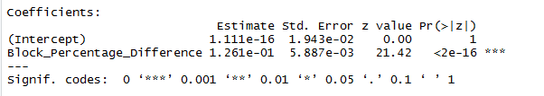
Creating a Baseline Model
We found Block Percentage to be a significant indicator of whether a team wins or not, so we used that as our Baseline Model
Notes:
Siwei

Slide 11
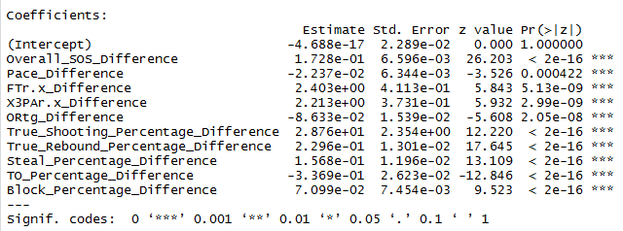
Creating Our Best Model
We assumed that using a variety of statistical categories would create the best model
Notes:
Siwei

Slide 12


Results
The 2017-18 Regular Season and Postseason games consisted of our testing dataset, which was 5,540 games Baseline Model: = 57.7%
Our Model: = 72.7%
Amount of Improvement: +829 = +15.0%
Notes:
Siwei

Slide 13
Conclusion
We tested 20+ different models in order to come up with the most accurate predictions Overall, we created an effective model at predicting which team would win a particular matchup (72.7% accuracy) Areas for Improvement: - We could have used more features into our model, instead of the features from our one dataset of season-long statistics - We could have tried different modeling techniques
Notes:
Zac

Slide 14
Any questions?

